Slide 1
Time Data
GeLSA

Slide 2
Time Data
Time Data
Time Data
Time Data
GeLSA
GeLSA
GeLSA
GeLSA

Slide 3
relationship among factors
network

Slide 4
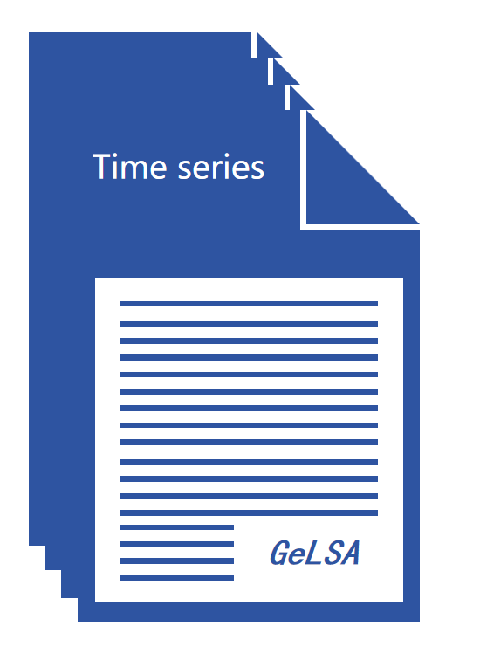
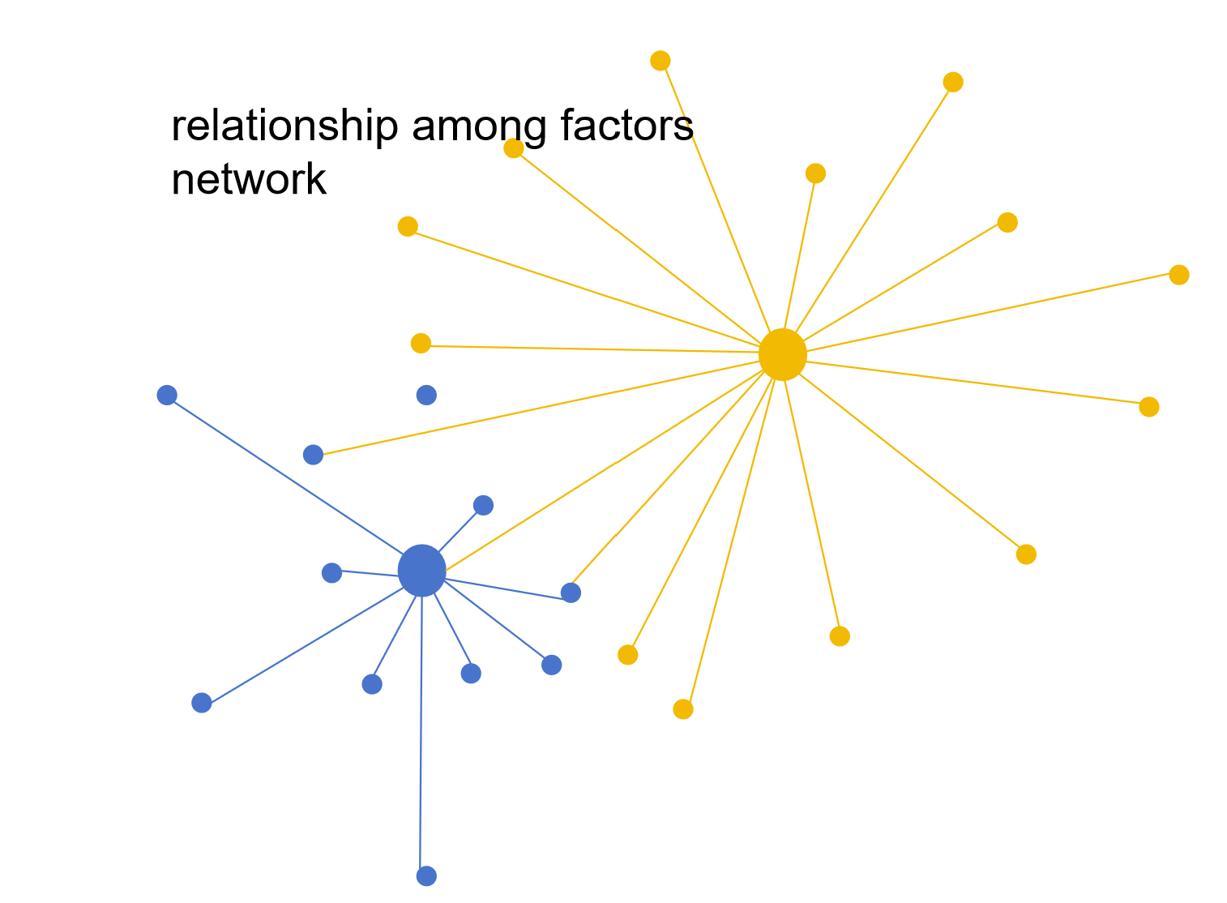
Multi-core CPU/GPU
Accelerated
Pairwise
Alignment
(GeLSA)
Series or Trend Alignment
Single
-core
Space
Permutation P
Bootstrap CI
Accelerated
Pairwise
Alignment
(GeLSA)
Series or Trend Alignment
Single
-core
Space
Permutation P
Bootstrap CI
data transformation
…
Transformated data
dispatch
Drawing
network
collect
Slave-master
Parallel
Computation
Pairwise Computation

Slide 5
数据处理
network

Slide 6
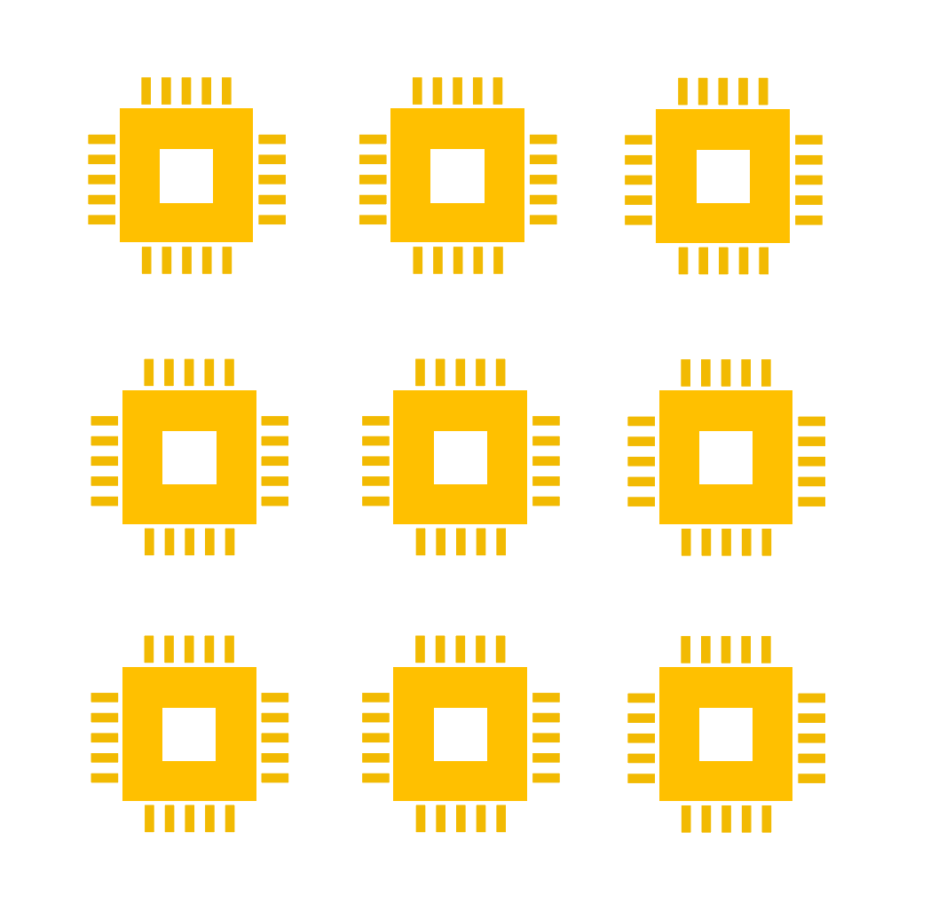
paralar analysis

Slide 7
Data transformation
Slave-master
Parallel
Computation
network
Pairwise
Computation
Transformated data

